Slide 1


ProCam Winter 2021
Martin Dahl
EE-550 Image and Video Processing

Slide 2
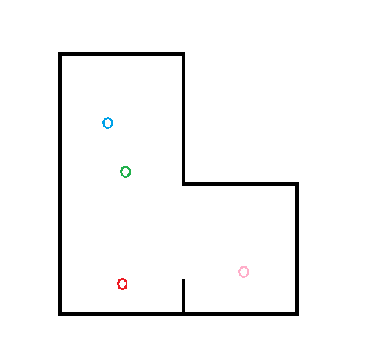
Problem

Slide 3
Problem
Many people in a room

Slide 4
Problem
Many people in a room
Requires more than one camera

Slide 5
Problem
Many people in a room
Requires more than one camera

Slide 6
Problem
Many people in a room
Requires more than one camera

Slide 7
Problem
Many people in a room
Requires more than one camera
Cameras should “know” if they look at the same person

Slide 8
Problem
Many people in a room
Requires more than one camera
Cameras should “know” if they look at the same person

Slide 9
Problem
Many people in a room
Requires more than one camera
Cameras should “know” if they look at the same person

Slide 10

Example
Data taken from Bruno Kessler Institute FBK TeV:
https://tev.fbk.eu/technologies/multi-camera-people-tracking-datasets

Slide 11
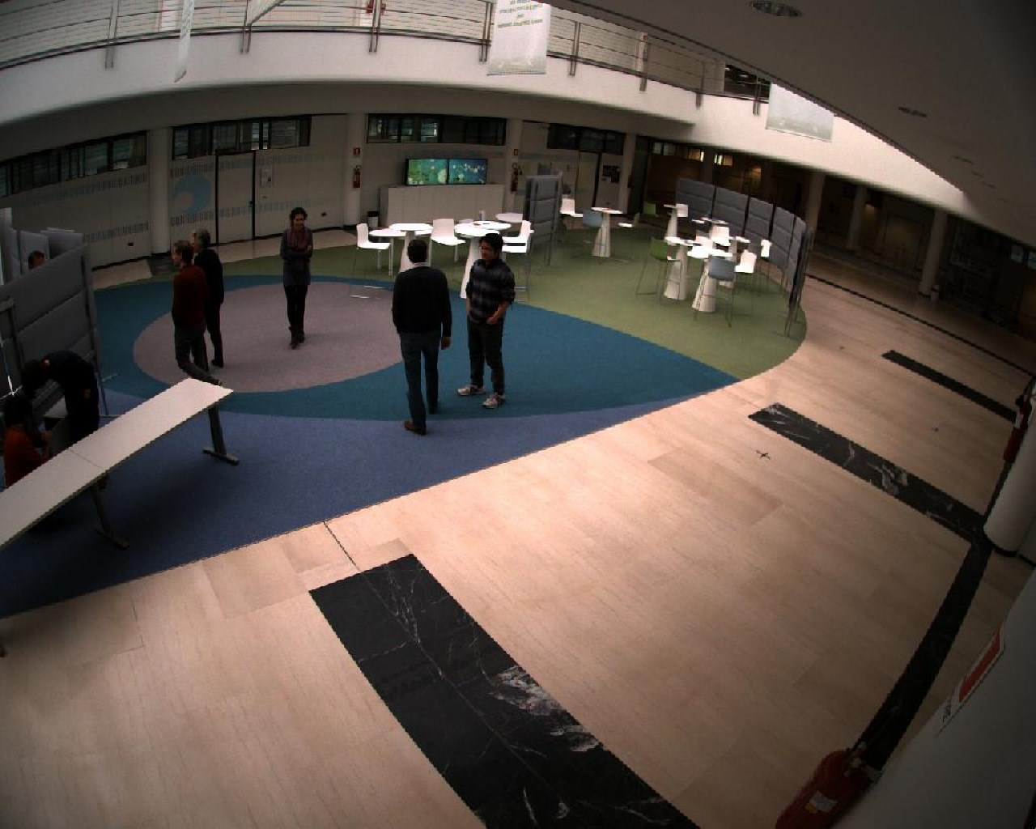
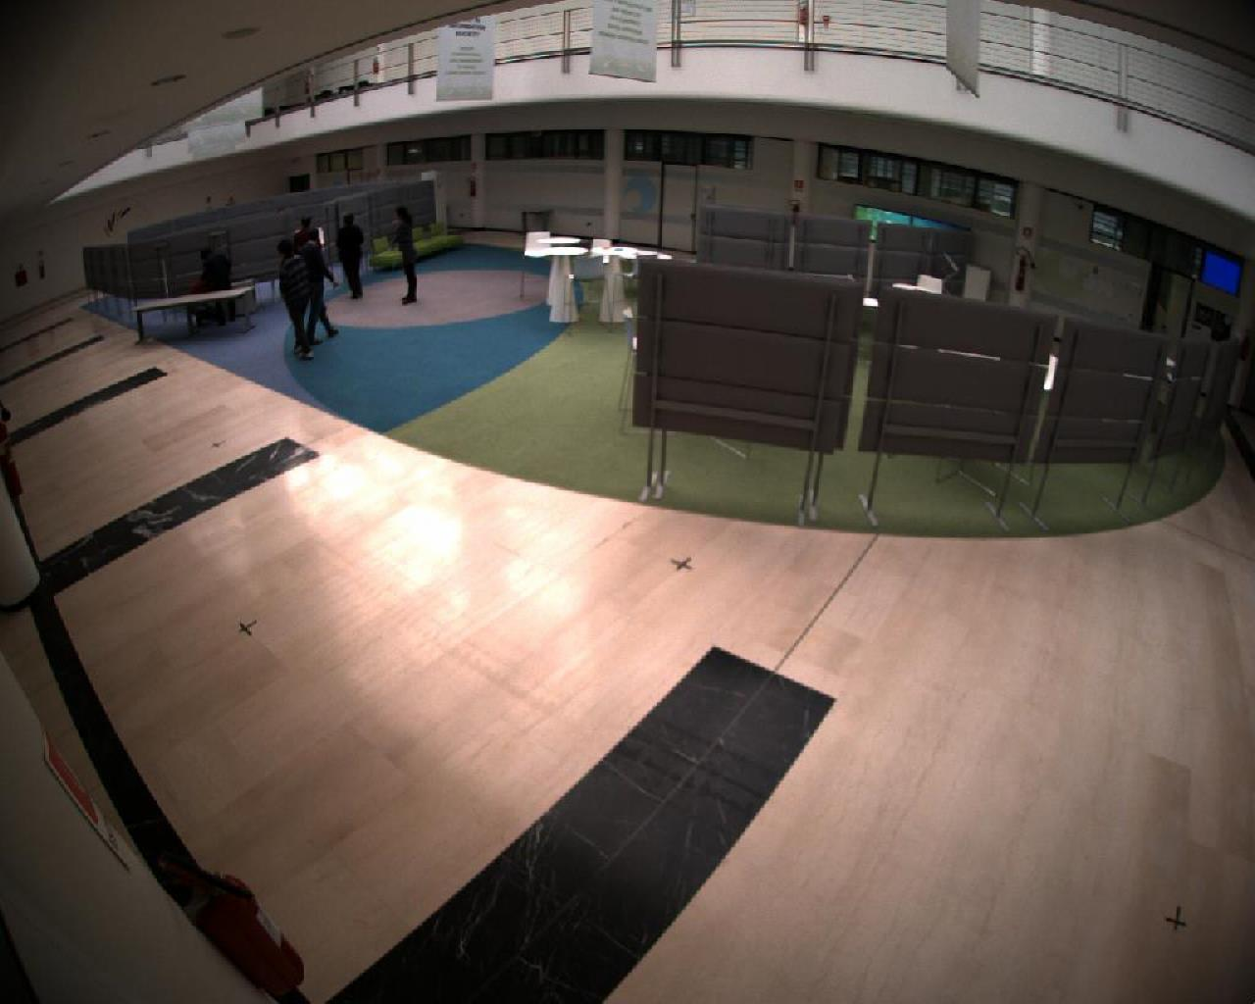
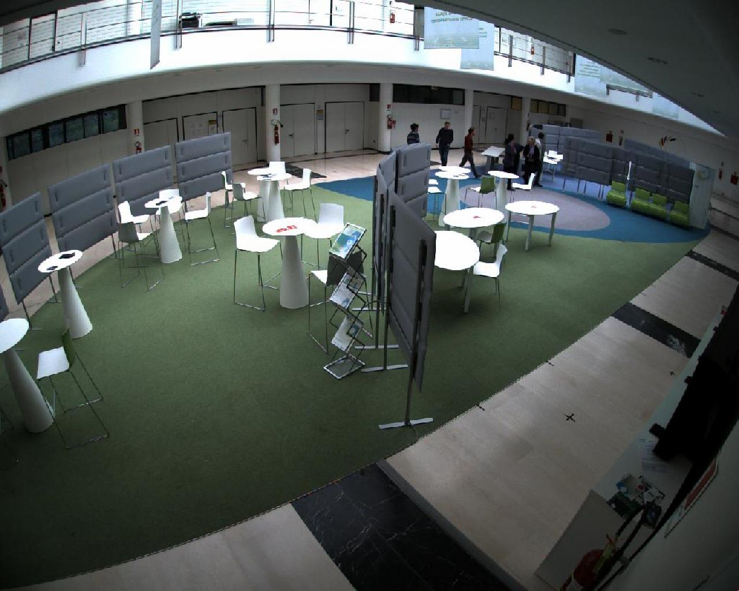
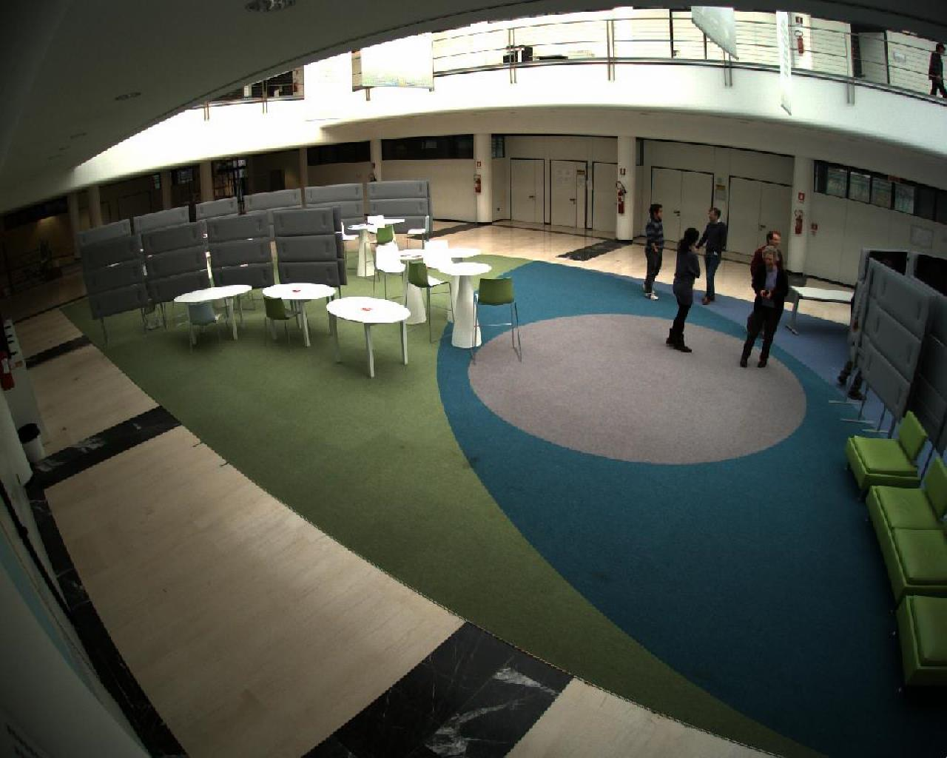
Example

Slide 12
Challenges

Slide 13
Challenges
Detecting persons

Slide 14
Challenges
Detecting persons
Recognizing persons

Slide 15
Challenges
Detecting persons
Recognizing persons
Recognition independent of pose and orientation

Slide 16
Challenges
Detecting persons
Recognizing persons
Recognition independent of pose and orientation
Lightning

Slide 17
Challenges
Detecting persons
Recognizing persons
Recognition independent of pose and orientation
Lightning
Visual obstructions

Slide 18


Challenges
Detecting persons
Recognizing persons
Recognition independent of pose and orientation
Lightning
Visual obstructions
Hard to get uniform data

Slide 19
Solution proposal
Neural Networks:
YOLOv5 for detecting persons
ResNet18 trained on custom dataset created with TeV dataset to recognize persons

Slide 20
Solution proposal – YOLOv5 person detection

Slide 21
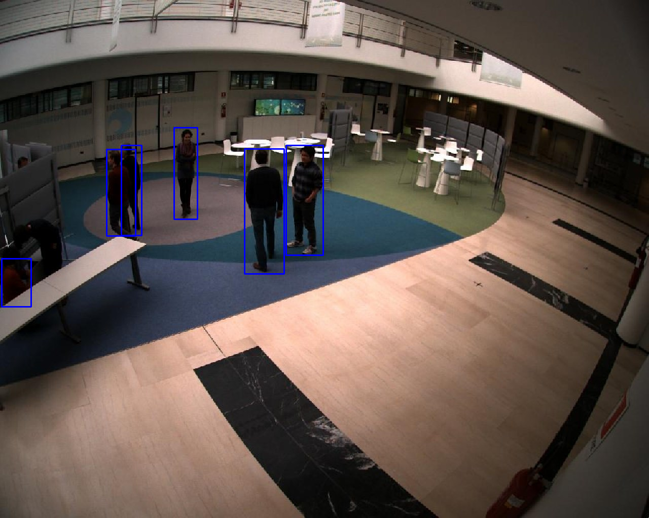
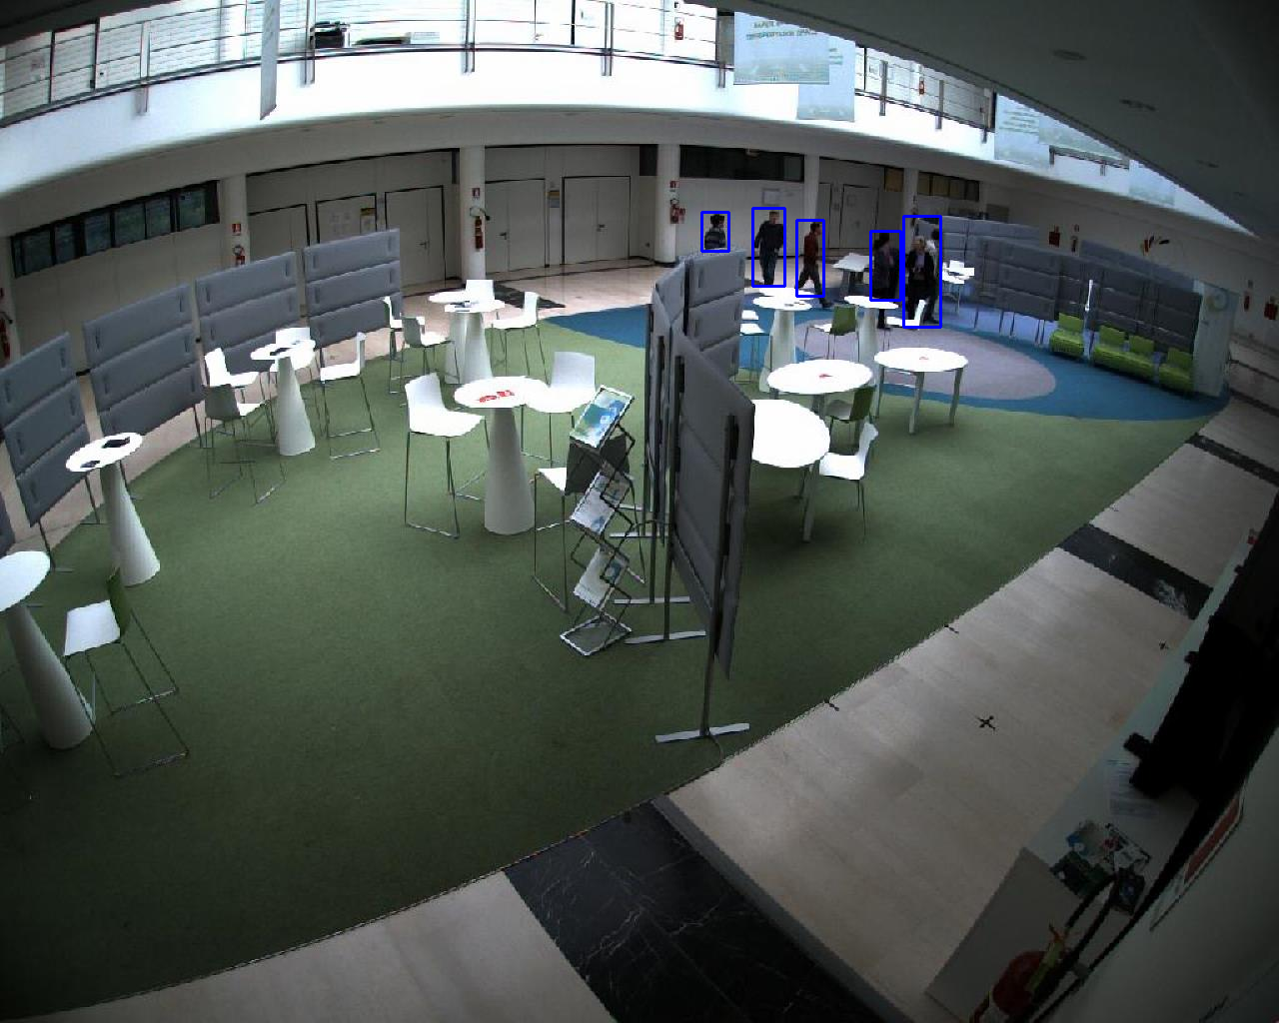
Solution proposal – YOLOv5 person detection

Slide 22
Solution proposal – Custom dataset

Slide 23
Solution proposal – Custom dataset

Slide 24

Solution proposal – Custom dataset

Slide 25
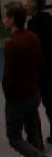
Solution proposal – Custom dataset

Slide 26
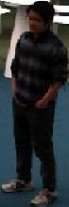
Solution proposal – Custom dataset

Slide 27
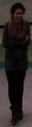
Solution proposal – Custom dataset

Slide 28
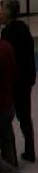
Solution proposal – Custom dataset

Slide 29

Solution proposal – Custom dataset

Slide 30
Solution proposal – Train network
Train ResNet18 on persons as classes
Only use the network for finding features
Compare feature vectors for detected persons in different cameras and match

Slide 31
ProCam Winter 2021
Martin Dahl
EE-550 Image and Video Processing

